Slide 1
The Application Layer Dr. Lixin Wang Professor TSYS School of Computer Science

Slide 2
Review for the App Layer
Default port numbers of common app-layer protocols:
HTTP: 80, HTTPS: 443
FTP: 20/21 (Why two ports are needed?)
SSH: 22
Telnet: 23
E-mail: 25

Slide 3

outline
Web and HTTP
DNS

Slide 4


HTTP overview
HTTP: HyperText Transfer Protocol
An application layer protocol used by a web server and a client browser
client/server model
client: browser that requests, receives, (using HTTP protocol) and “displays” Web objects
server: Web server sends (using HTTP protocol) objects in response to HTTP requests
HTTP request
PC running
A web browser
HTTP response
HTTP request
server
running
Apache Web
server
HTTP response
iPhone running
Safari browser

Slide 5
Underlying trans-layer protocol: TCP
client initiates TCP connection (creates socket) to server, default port 80
server accepts TCP connection from client
HTTP messages exchanged between a browser (HTTP client) and a Web server (HTTP server)
HTTP is “stateless”
A Web server maintains no information about past client requests
Questions:
How does a Web server know whether a user is new or returned?
Notes:
An HTTP cookie is a small piece of data sent from a website and stored on the user's computer by the user's web browser while the user is browsing. Cookies were designed to be a reliable mechanism for websites to remember stateful information (such as items added in the shopping cart in an online store) or to record the user's browsing activity (including clicking particular buttons, logging in, or recording which pages were visited in the past).

Slide 6
Two types of HTTP messages
request
response

Slide 7

HTTP request message (an example)
ASCII (human-readable format)
carriage return character
request line
(GET, POST,
HEAD commands)
line-feed character
GET /index.html HTTP/1.1\r\n
Host: www-net.cs.umass.edu\r\n
User-Agent: Firefox/3.6.10\r\n
Accept: text/html,application/xhtml+xml\r\n
Accept-Language: en-us,en;q=0.5\r\n
Accept-Encoding: gzip,deflate\r\n
Accept-Charset: ISO-8859-1,utf-8;q=0.7\r\n
Keep-Alive: 115\r\n
Connection: keep-alive\r\n
\r\n
header
lines
Keeps the TCP
connection alive
Accept header lines give the
browser a chance to tell the Web server what format it wants for resources
Header ends

Slide 8

HTTP request message: general format
request
line
method
sp
URI
sp
version
cr
lf
header field name
value
cr
lf
~
~
header
lines
~
~
header field name
value
cr
lf
cr
lf
~
entity body
~
message
body
~
~
URI: Uniform Resource Identifier

Slide 9
Request method types
HTTP/1.0 (3 methods):
GET: retrieve whatever information is identified by the Request-URI
POST: often used when the user fill out a form. The name/value pairs will be uploaded to the server when the form is submitted
HEAD: The HEAD method is identical to GET except that the server MUST NOT return a message-body in the response

Slide 10
Request method types (2)
HTTP/1.1 (5 methods):
GET, POST, HEAD
PUT
uploads a file in the entity body to the path specified in the URI field
DELETE
deletes a file specified in the URI field

Slide 11
HTTP response message (an example)
status line
(protocol
status code
status phrase)
HTTP/1.1 200 OK\r\n
Date: Sun, 26 Sep 2010 20:09:20 GMT\r\n
Server: Apache/2.0.52 (CentOS)\r\n
Last-Modified: Tue, 30 Oct 2007 17:00:02 GMT\r\n
ETag: "17dc6-a5c-bf716880"\r\n
Accept-Ranges: bytes\r\n
Content-Length: 2652\r\n
Keep-Alive: timeout=10, max=100\r\n
Connection: Keep-Alive\r\n
Content-Type: text/html; charset=ISO-8859-1\r\n
\r\n
data data data data data ...(message body)
header
lines
data, e.g.,
requested
HTML file

Slide 12
HTTP response status codes
status code appears in 1st line in server-to-client response message.
some sample codes:
200 OK
request succeeded, requested object later in this msg
301 Moved Permanently
requested object moved, new location specified later in this msg (Location:)
400 Bad Request
request msg not understood by the Web server
404 Not Found
requested document not found on this server
500+ Fatal Errors
505 HTTP Version Not Supported

Slide 13
outline
Web and HTTP
DNS

Slide 14
DNS – Domain Name System
The DNS resolves high-level human readable names for computers to low-level IP addresses
E.g.: www.amazon.com
It resolves domain names into numerical IP addresses
Question: Why Do We Need DNS? (Why don’t we use the IP address of the Amazon webserver?)

Slide 15
Why We Need DNS?
Programs could refer to Web pages and other resources by using IP addresses of the servers, but these IP addresses are hard to remember
Servers’ IP addresses could change over time
High-level, readable names were introduced in order to decouple the domain names from IP addresses
Computers ONLY understand numerical IP addresses, some mechanism is required to convert the names to IP addresses

Slide 16

How a DNS server work?

Slide 17
Three Topics on DNS
DNS domain namespace »
Domain Resource records »
Name servers »

Slide 18
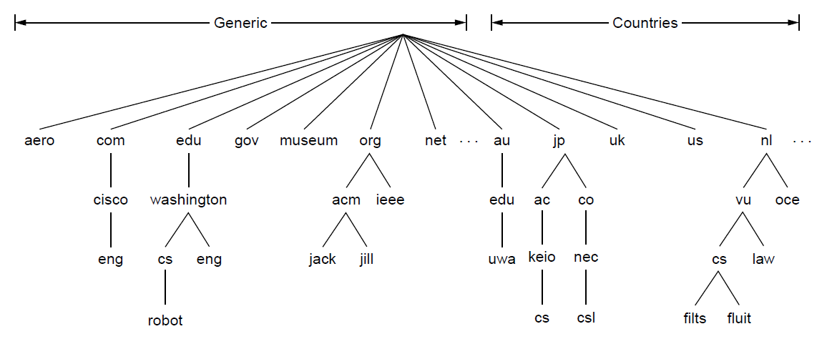
The DNS Name Space
DNS domain namespace is hierarchical from the root down
Each domain is named by the path upward from it to the (unnamed) root such as robot.cs.washington.edu
A leaf domain may contain a single host, or represent an organization/company - containing thousands of hosts
The computer robot.cs.washington.edu

Slide 19
Top-level Domains
The Internet is divided into over 250 top-level domains, each covers many hosts
Top-level domains
The computer robot.cs.washington.edu

Slide 20
Top-level Domains (2)
All these domains can be represented by a tree structure
The top-level domains come in two flavors: generic and countries
Generic: are run by registrars appointed by ICANN (Internet Corporation for Assigned Names and Numbers)
Countries: includes one entry for every country

Slide 21
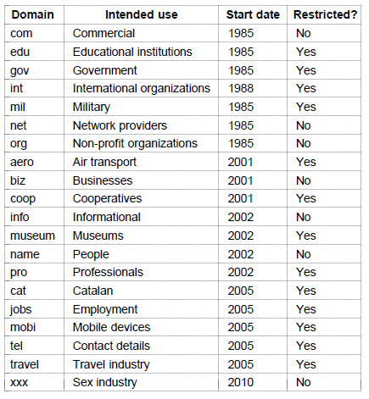
Generic top-level domains
Notes:
The top-level domains are run by registrars appointed by ICANN

Slide 22
Domain Resource Records
Every domain, whether it is a single host or a top-level domain, can have a set of resource records associated with it
These records are the DNS database
For a single host, the most common resource record is just its IP address
The primary function of DNS is to map domain names onto resource records
When a resolver gives a domain name to a DNS server, what it gets back are the resource records associated with that domain name

Slide 23
Domain Resource Records (2)
A domain resource record is a five-tuple
Domain name: tells the domain to which this record applies
Time to live: an indication of how stable a record is
Info highly stable - a large value, such as 86400 (1 day)
Info highly volatile - a small value, such as 60 (1 min)
Class: IN (Internet Information)
Type: what kind of record this is
Value: a number, a domain name, or an ASCII string

Slide 24
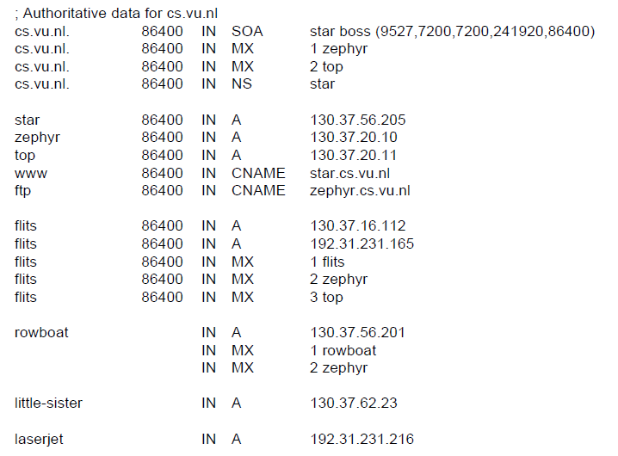
An Example of DNS database (5 columns)
Name server
IP addresses of computers
CNAME
A portion of a possible DNS database for cs.vu.nl.

Slide 25
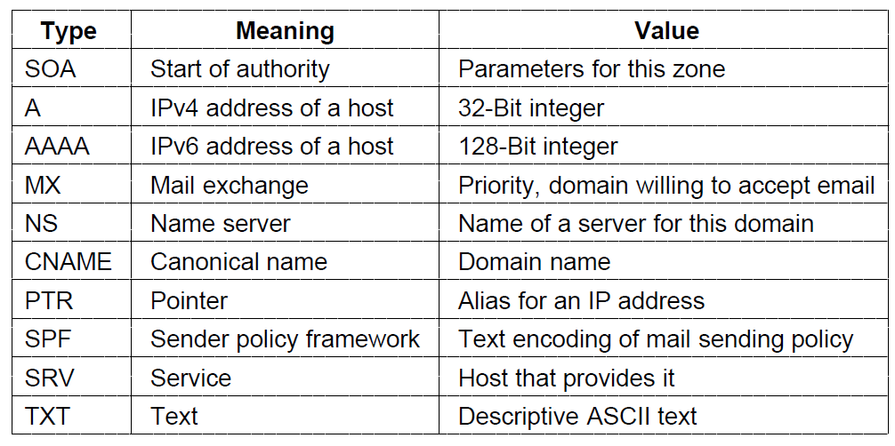
Domain Resource Records (3)
The key resource records in the namespace are
IP addresses (A / AAAA) and
Name servers (NS)

Slide 26
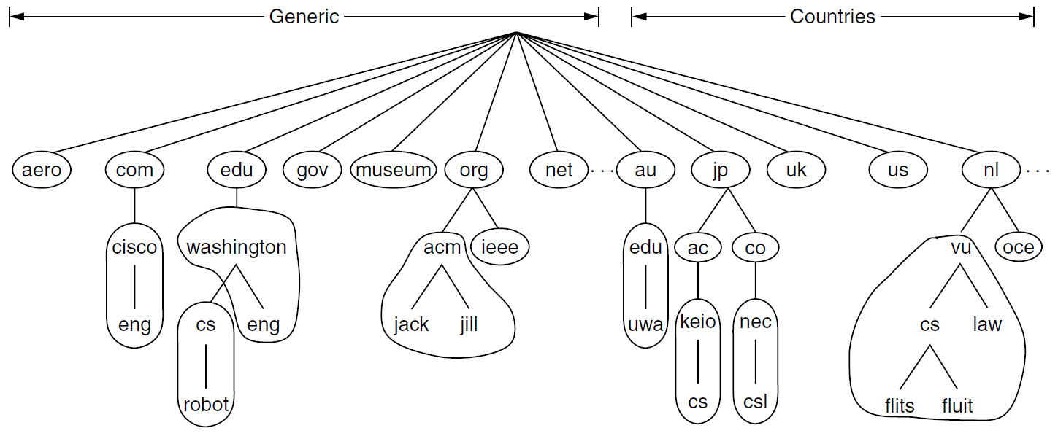
Domain Resource Records (4)
SOA provides the name of the primary source of information about the name server’s zone
A zone is a portion of the DNS namespace that is managed by a specific organization or administrator

Slide 27
Domain Resource Records (5)
NS specifies a name server for the domain or subdomain
a host holding a copy of the database for a domain
used as part of the process to look up names
CNAME records allow aliases to be created. E.g.,
Domain name for M.I.T.’s CS department is csail.mit.edu
People may think it would be cs.mit.edu
M.I.T. could create a CNAME entry to point people in the right direction as follows:
cs.mit.edu 86400 IN CNAME csail.mit.edu

Slide 28
Name Servers (1)
A simple design for DNS would have one centralized DNS server that contains all the mappings
In this centralized design, clients simply direct all queries to the single DNS server, and the DNS server responds directly to the querying clients
Although the simplicity of this design is attractive, it is inappropriate for today’s Internet, with its vast (and growing) number of hosts and domain names
Question: What are the problems with this simple design?

Slide 29
Name Servers (2)
A single point of failure. If the DNS server crashes, so does the entire Internet!
Traffic volume. A single DNS server would have to handle all DNS queries (for all the DNS requests and responses from millions of hosts)
Distant centralized database. A single DNS server cannot be “close to” all the querying clients. This can lead to significant delays
Maintenance. The single DNS server would have to keep records for all the hosts on the Internet. Not only would this centralized database be huge, but it would have to be updated frequently to account for every new host

Slide 30
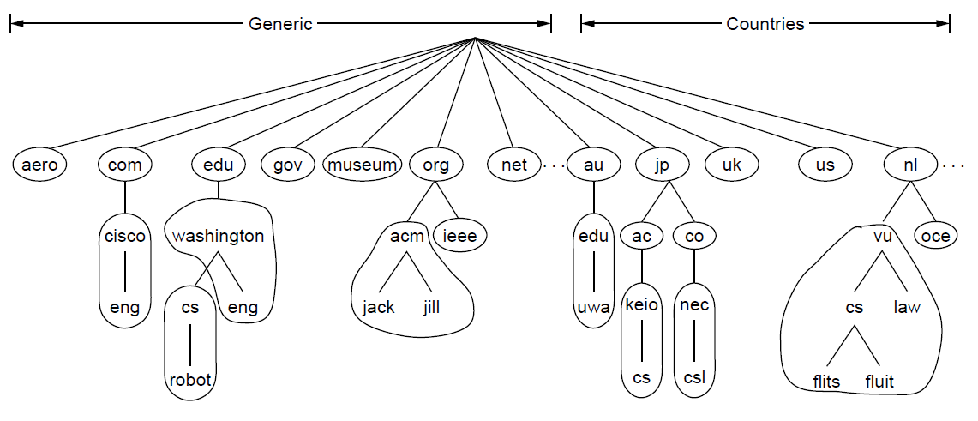
Name Servers (3)
The DNS domain namespace is divided into non-overlapping zones (circled)
A DNS zone is a portion of the DNS namespace managed by a specific organization
One zone

Slide 31
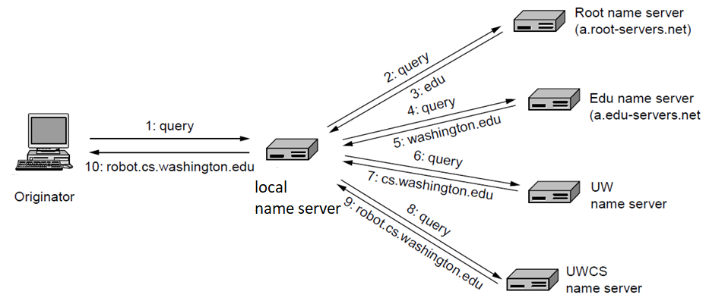
Name Servers (4)
If no cached information about the queried domain name in the local name server, it begins the process of a remote query
Example of a computer looking up the IP for a domain name

Slide 32
Port Numbers used by DNS Services
DNS was designed to use both UDP and TCP port 53
By default, DNS mostly runs on UDP port 53 from the start
DNS falls back to using TCP port 53 when it is unable to communicate on UDP
Typically, when the packet size is too large to push through in a single UDP packet for DNS services

Slide 33
When DNS Switches to TCP port 53?
switches to use TCP port 53 when packet size is too large to push through in a single UDP packet
In DNS design, UDP packet payload size is limited to 512 bytes (Why are DNS inquiry packets small?)
to optimize performance (minimizing the network traffic generated)
What kinds of DNS messages exceed 512 bytes?
DNS zone transfers are usually done to replicate DNS data to a number of different DNS servers
With a DNS zone transfer, primary and secondary DNS servers can exchange data with each other, including all the resource records in DNS database

Slide 34
More Review Questions
What is the content of the first line of an HTTP response message?
What is the content of the first line of an HTTP request message?
If the HTTP response status code is 404, what does it mean?
What is the purpose of using the Accept Headers in an HTTP request message?
What are the advantage of HTTP/1.1 over HTTP/1.0?

Slide 35
More Review Questions (2)
Explain how the HTTP protocol supports for pipelining requests
Explain how the HTTP protocol supports for client-side caching
Why is HTTP designed to “stateless”? What does it mean?
What is a dynamic web page?
What is a static web page?

Slide 36
More Review Questions (3)
Why is the DNS protocol needed?
How is the DNS namespace organized?
What is the primary function of DNS?
What is a domain resource record?
What is done with the DNS protocol resolution?
How does a DNS server work?
By default, on which port is DNS running?
If there is no cached information about the domain available locally, what does the name server do?

